Slide 1
Food Access Strategies
Kim Etingoff
Program Coordinator, MDPH
Kim.etingoff@state.ma.us
Notes:
About me: Mass in Motion Program Coordinator at Massachusetts Department of Public Health; background as a planner, has worked on development of community food system plan, food resiliency planning, communications and evaluation of food access work, and nutrition and agricultural programming. Focus on equitable processes and outcomes.

Slide 2
Food choices/experiences and nutrition and health outcomes are influenced by:
Regulatory decisions
Zoning regulations
Transportation pathways
Connectivity between food system steps
Who is making the decision
Etc.
Policy, systems, and environmental change
Notes:
Why food? Food has a direct connection with health outcomes such as obesity, diabetes, etc, but is also indirectly tied to health outcomes, community vitality, and social capital. Food is an engaging tool useful for empowering people to make healthier decisions and to change systems.
Public health work has been shifting from a behavioral/programmatic approach to policy, systems, and environmental change since food choices and experiences are a result of things like regulatory decisions, etc.

Slide 3
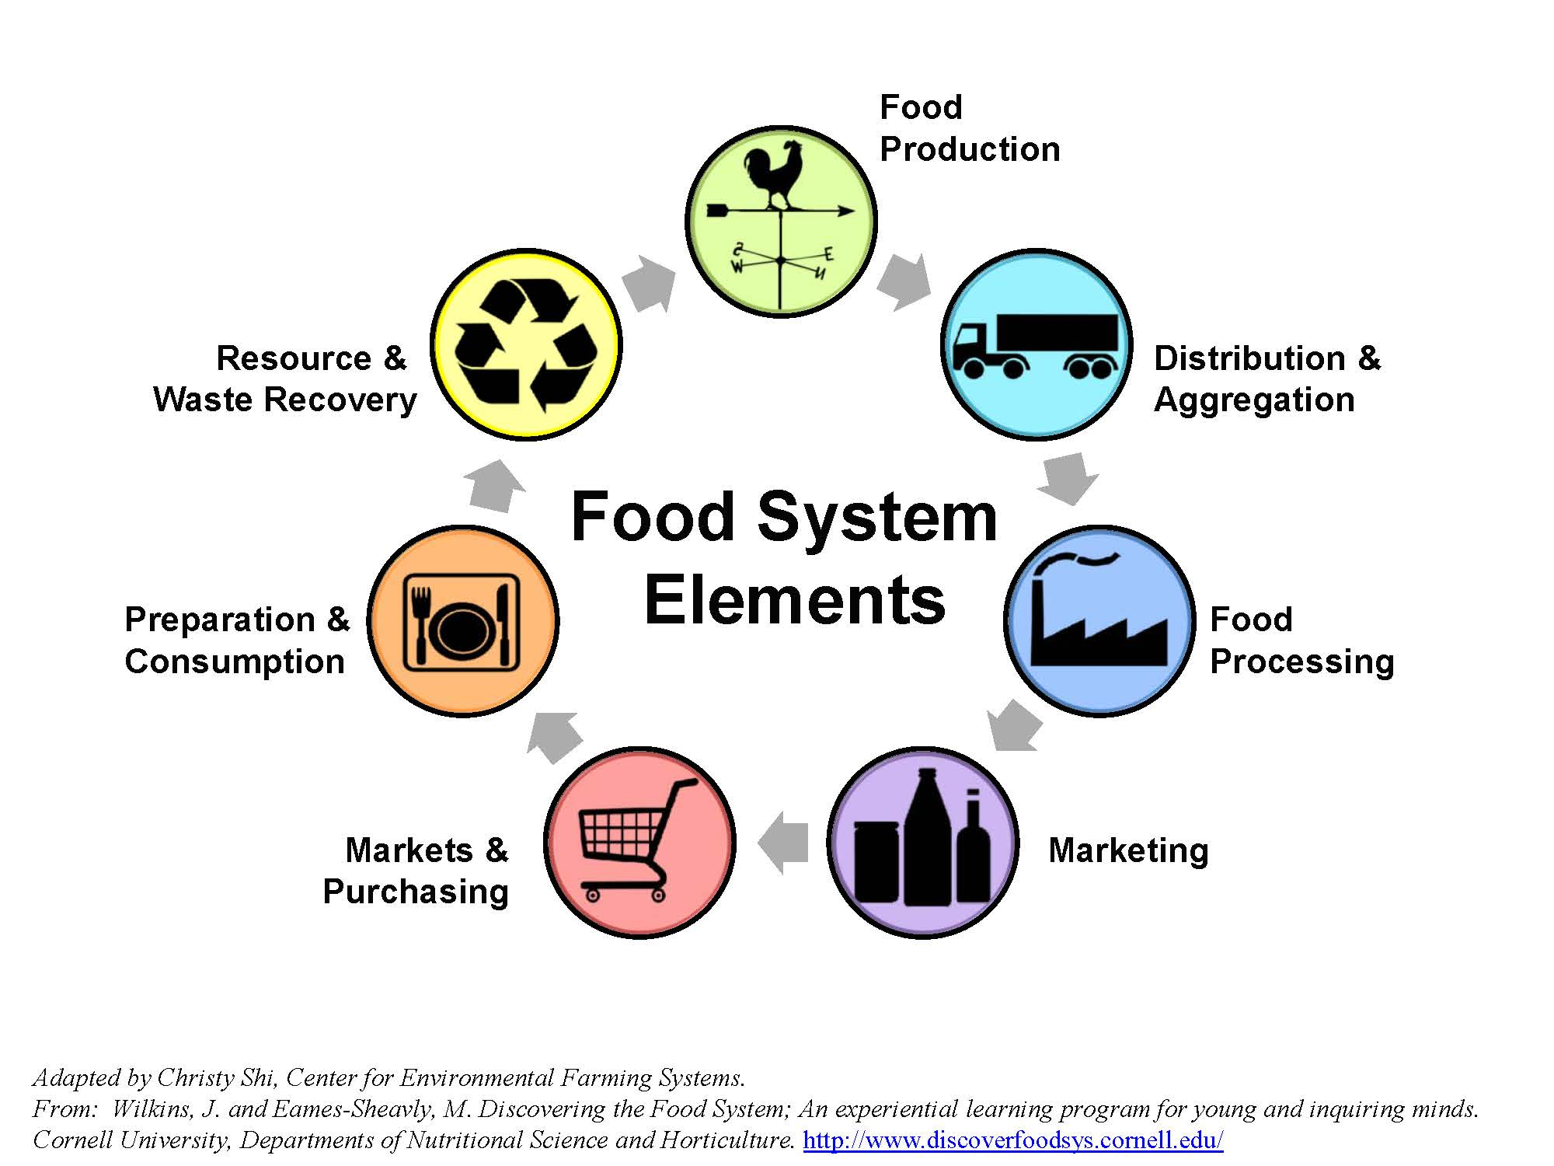
Notes:
A useful way to think about your own food access work is to fit it into the steps involved in food systems. Behavioral work usually focuses on the preparation and consumption step, but we are encouraging applicants to think about other steps further back in the chain, such as distribution or retail.

Slide 4
Retail Access
Municipal Policy
Data Collection and Analysis
Notes:
The following suggested strategies are grouped into three buckets: retail access, municipal policy, data collection and analysis. You do not have to use any of these strategies, but they provide examples of the type of work we are encouraging. The suggested strategies are based on success in Mass in Motion communities, as well as challenges and areas of food access work that MiM communities have identified as priorities moving forward.

Slide 5
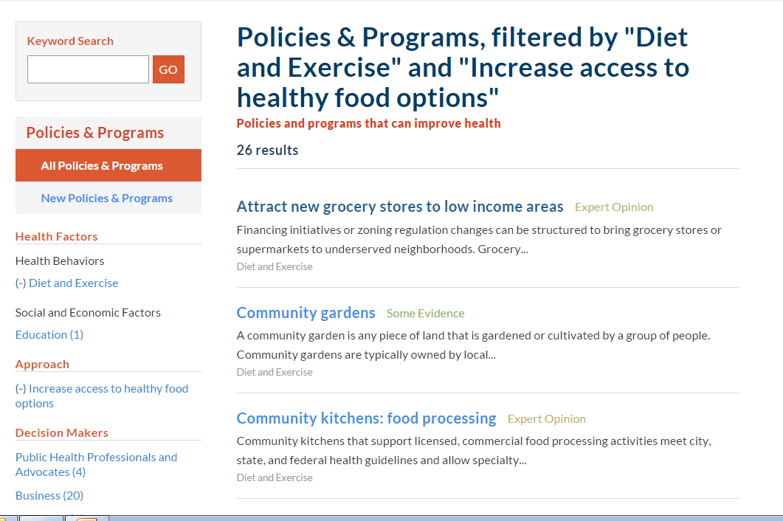
Notes:
Useful tool for deciding on food access strategies: Robert Wood Johnson County Health Rankings System includes a database comparing evidence base for many strategies.
http://www.countyhealthrankings.org/policies

Slide 6
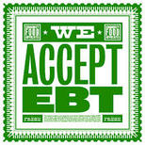
Retail access
Supporting SNAP capabilities at corner stores and farmers markets
Work with small retailers to increase SNAP availability.
Options: Identify stores in areas of highest need, provide assistance for SNAP sign up, OR develop outreach strategy and tools including multi-lingual signage.
Notes:
One of the main challenges in keeping healthy food affordable in corner stores and farmers markets is stores’ ability to accept and maintain SNAP. These funds may be used to understand the barriers to SNAP at either type of site, or to move forward in providing SNAP support. Funds may also be used to buy EBT systems. (Farmers markets can get free SNAP/WIC machines from the USDA, but not systems that also accept credit/debit cards.)

Slide 7

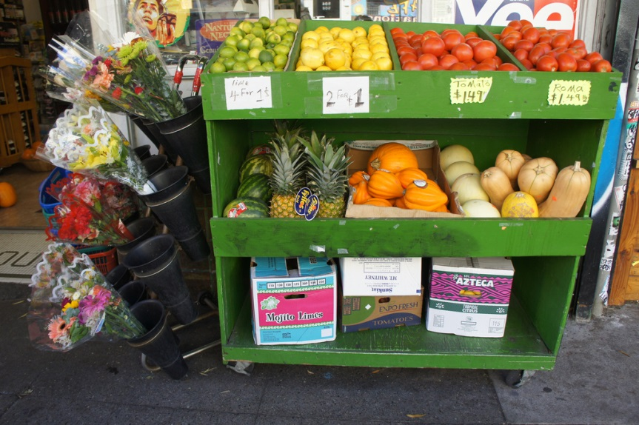
Retail access
Corner store distribution
Address healthy food distribution challenges in corner stores.
Options: Conduct a feasibility study of working with the appropriate Regional Planning Agency to create a regional corner store association/food distribution network OR work with MAPC on current corner store association effort.
“Corner Store Grocery produce," Lynn Friedman, link
Notes:
Healthy food, esp. produce, distribution is a major challenge in healthy corner store work. Individual stores don’t have the benefit of aggregated or large purchasing and generally have very informal practices of distribution (go to a big box store and buy pallets to bring back), so they don’t keep things in stock and charge high prices.
MAPC currently forming the Greater Boston Association of Convenience Stores to strengthen businesses and increase their positive impact on communities. The association will provide cost-saving benefits like aggregated purchasing, along with TA and networking. The goal is to promote healthier products at corner stores. The project will be recruiting stores Jan-March.
If you don’t fall under MAPC’s jurisdiction, you can use them for assistance and work with your own RPA

Slide 8
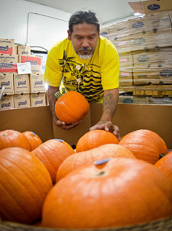
Retail access
Food pantry nutrition policies
Support efforts to introduce more nutritious food at local food pantries.
Options: Determine state of nutrition policies at local food pantries and introduce new policies OR support operationalizing of existing policies
“20111031-FNS-LSC-0396,” USDA, link
Notes:
Pantries may or may not have formal commitments to healthy foods, though more and more food banks do- Greater Boston Food Bank does, other MA food banks have healthy food language in mission or nutrition programming
Some pantries may be worried about offending donors by refusing unhealthy food, but creating a nutrition policy provides an opportunity to engage regular donors in a discussion about healthy food

Slide 9
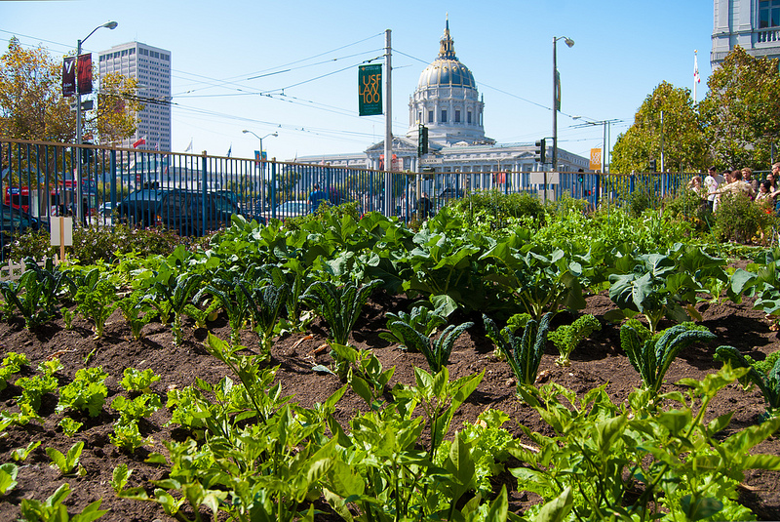
Municipal policy
Urban agriculture ordinances
Move municipalities toward adoption of urban agriculture policies.
Options: Conduct feasibility study of an urban agriculture ordinance OR develop ordinance language
“Tenderloin People's Garden,” SPUR, link
Notes:
In Massachusetts, Somerville and Boston have passed comprehensive ordinances; Everett and Cambridge working toward that goal
Urban ag ordinances specifically address commercial agriculture, can include chickens, bees, rooftop farms, aquaculture, farm stands, farmers markets

Slide 10
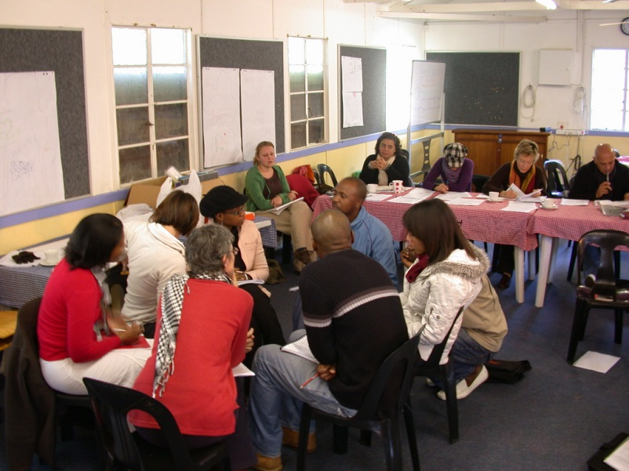
Municipal policy
Food planning efforts
Support efforts to include food access in municipal planning and policymaking.
Options: Take steps to convene a local food policy council, conduct a local policy scan for relevant policies affecting food access and food systems, OR work toward a municipal food plan
“Day 28.06 Happy B'day mum!,” Frerleke, link
Notes:
Planning efforts can be around any or all steps of the food system, either within one municipality or regionally
This is a large, multi-year strategy, so these funds would be most appropriate for a discrete step in the food planning process
Examples of current food planning efforts include the MA Food Plan that was just released: http://www.mafoodplan.org/

Slide 11
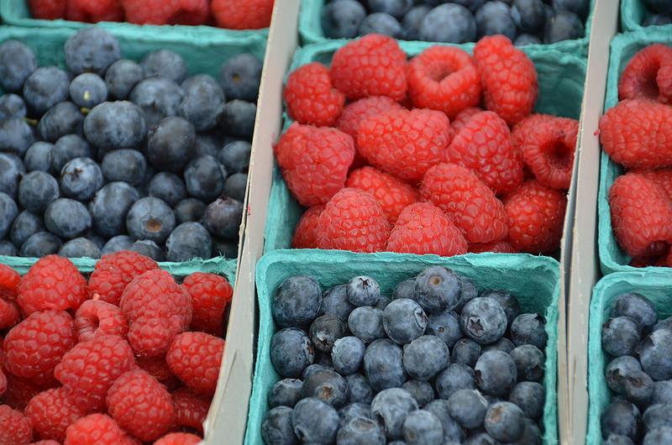
Municipal policy
Farmers Market-friendly policies
Work with municipalities to reduce permitting barriers to farmers markets, such as granting variance requests through the local Board of Health
“Hillcrest Farmers Market,” Rob Bertholf, link
Notes:
Work to grant variances for markets around cooking demos, displays, etc., change zoning to allow farmers markets in ideal places

Slide 12
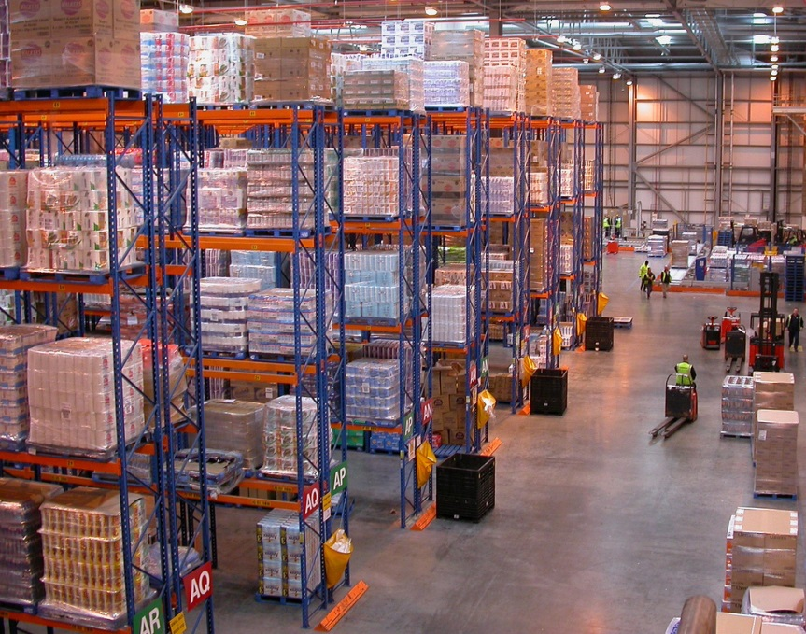
Data collection and analysis
Food distribution studies
Collect data and report on food distribution networks, either general or specific (emergency food system, large retail, corner stores, etc.)
“Distribution centre,” Nick Saltmarsh, link
Notes:
Very little data is publically available on food distribution- need more information to figure out how to address distribution difficulties.
These funds could be used as the first step in determining data needs, starting data collection including interviewing or getting quantitative data

Slide 13
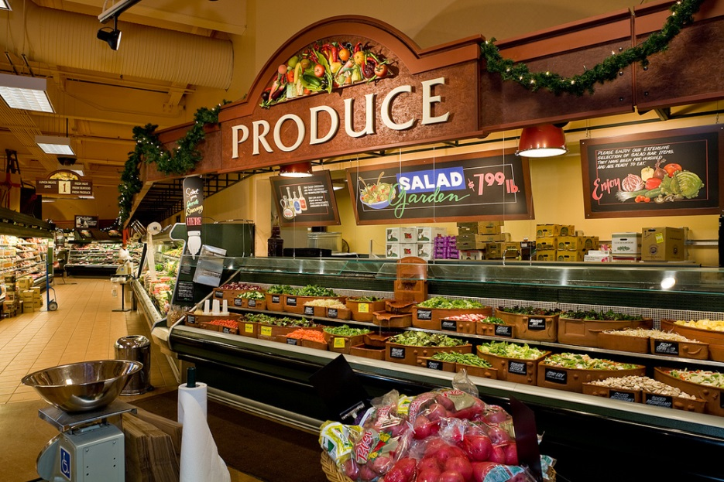
Data collection and analysis
Large retail feasibility
Conduct economic feasibility study of large grocery stores in neighborhoods with limited access to fresh, healthy foods.
“Interior Thriftway Décor | Grocery Produce Area | Interior Grocery Signage | Market Decor Design | Admiral Thriftway,” I-5 Design & Manufacture, link
Notes:
Neighborhoods or whole communities may have no access to large grocery, especially low income areas
Funds can be used as part of a larger feasibility study, or for a smaller step involved in a study; good way to work with your RPA on a larger project

Slide 14
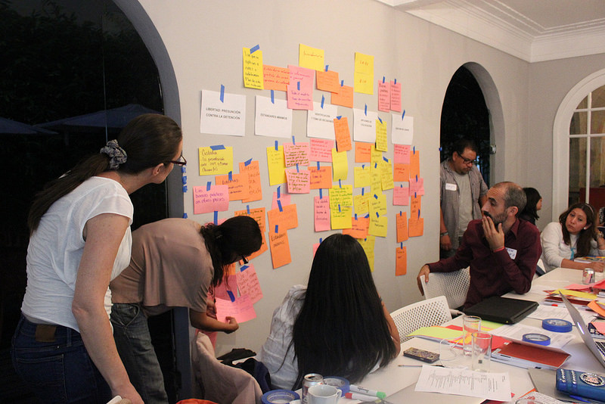
Data collection and analysis
Community food assessment
Conduct one or more steps in a community food assessment of a municipality or region.
Options: Implement food retail surveying, map community food assets, conduct a household food security assessment, etc.
“Taller sobre Incidencia en México / Mexico Advocacy Workshop,” Communications International, link
Notes:
A community food assessment can be a months- or years-long process, and dovetails nicely with other food planning efforts. Assessments are great ways to get residents and other stakeholders involved in the decision-making process around food access.

